Slide 1

Modelling Anthropogenic Climate Change
By Thomas Davies
Supervised by: Craig P. Testrow & Richard J. Wilman
Department of Physics, Durham University

Slide 2
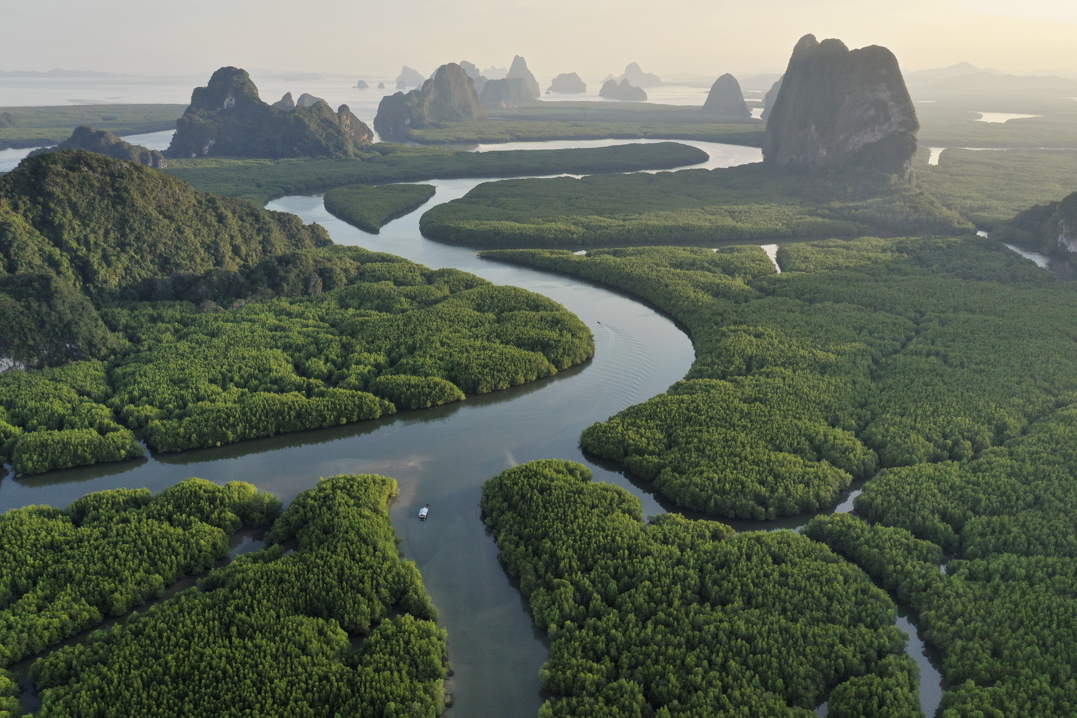
Seminar Outline
History of the Climate
Q & A
Project Goal
Possible future scenarios and climate consequences
Modelling Earth’s Climate

Slide 3
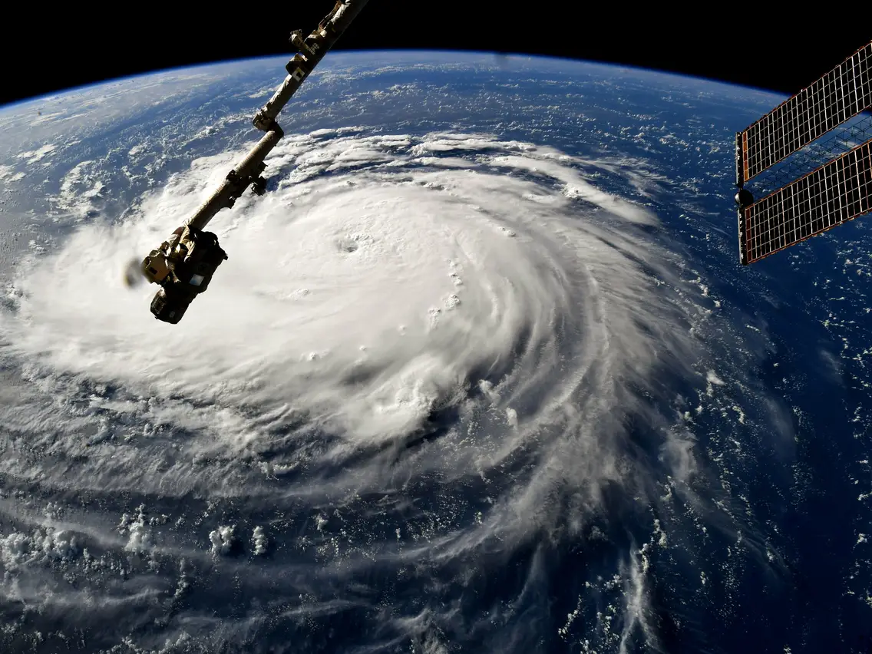
History of the Climate

Slide 4
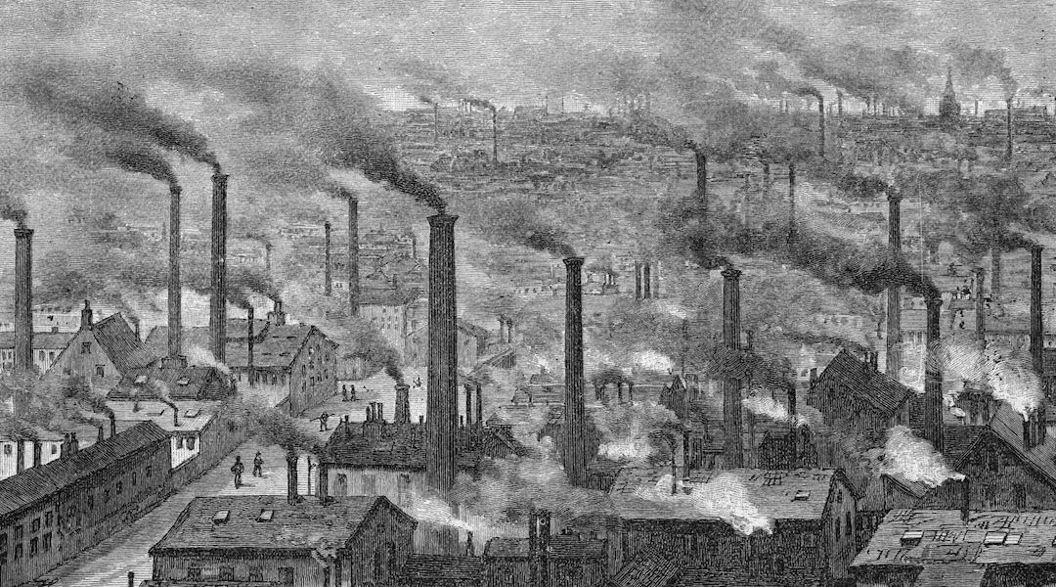
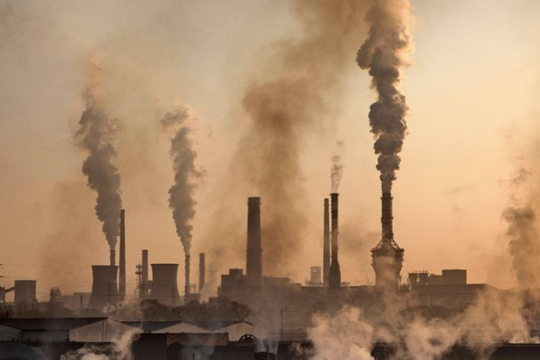
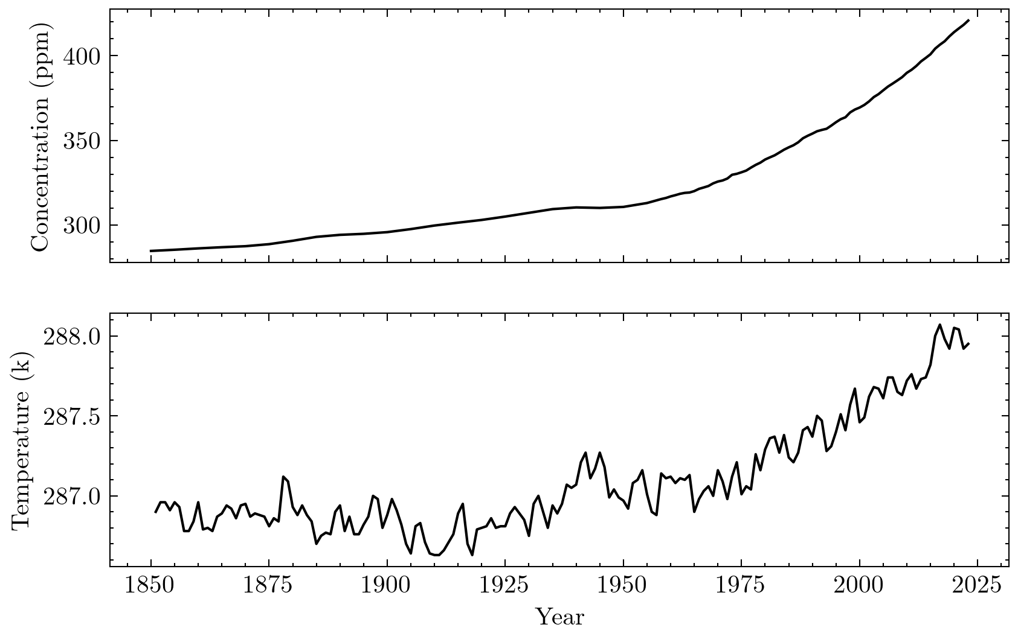
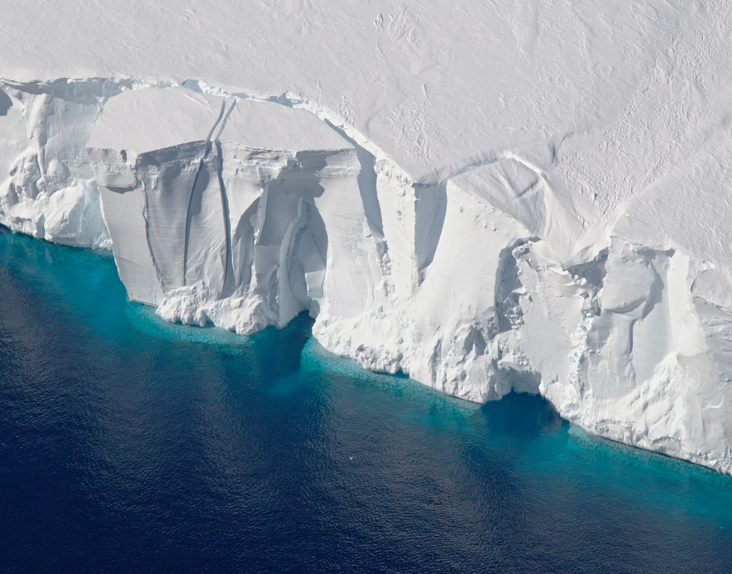
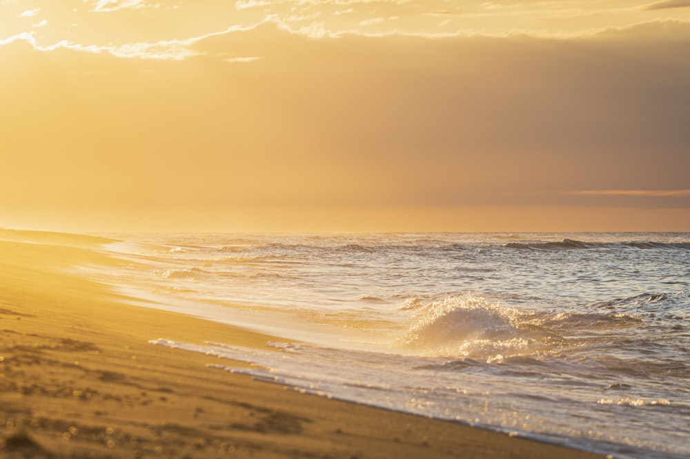
Atmospheric CO2 levels
Why is atmospheric CO2 increasing?
How does this effect global temperature?

Slide 5
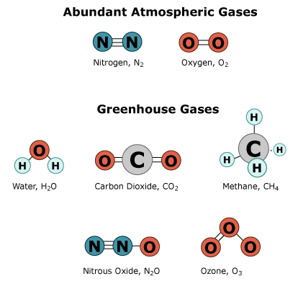
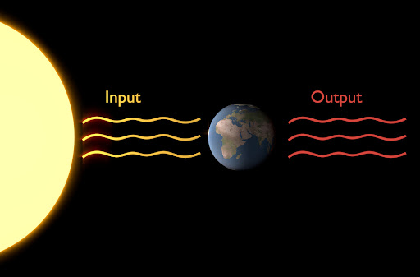
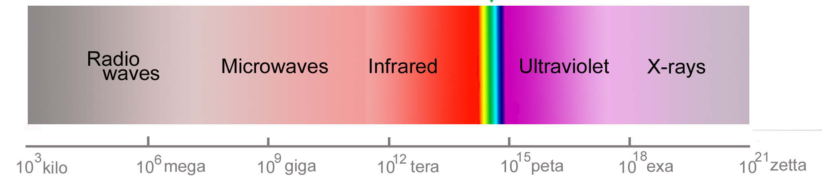
The Greenhouse effect
What is a greenhouse gas?
How do they effect global temperature?

Slide 6
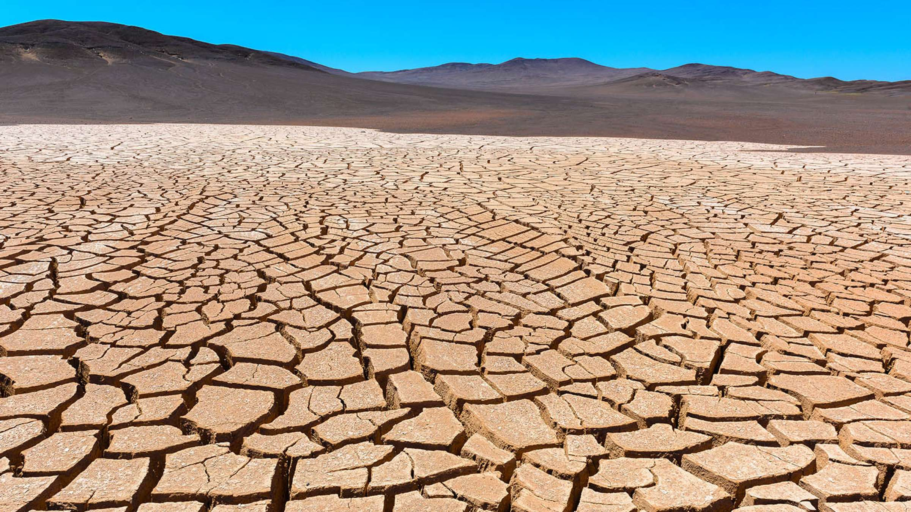
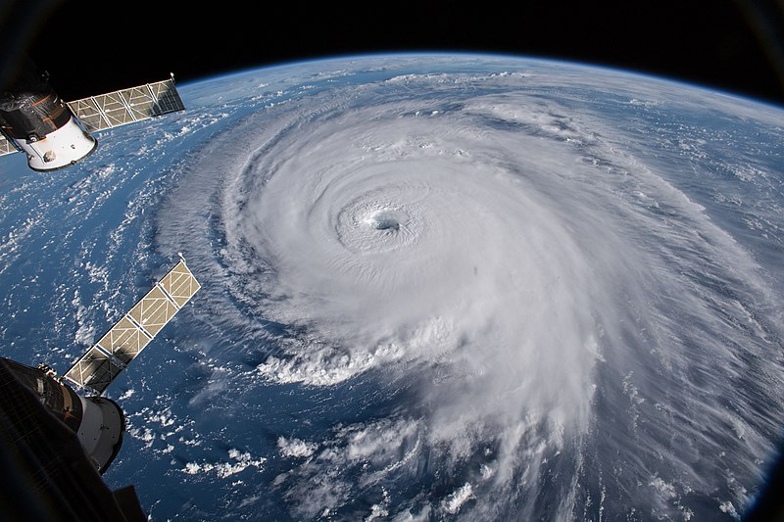
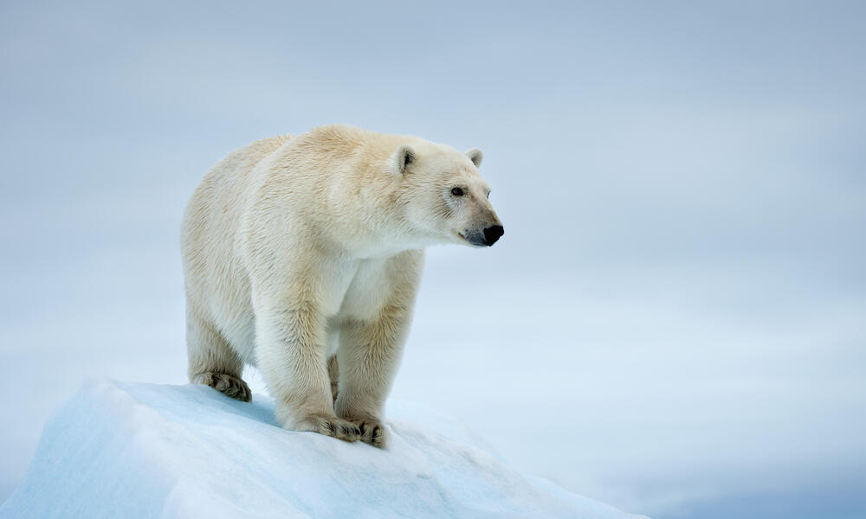
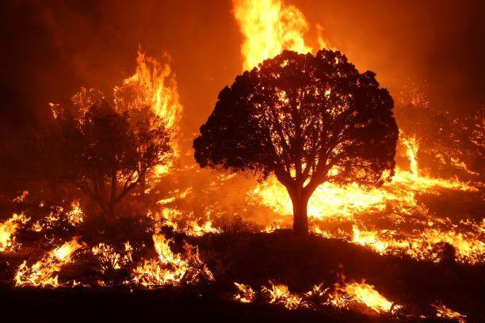
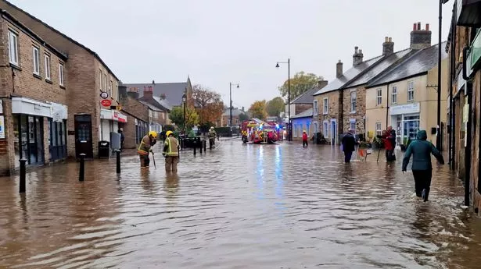
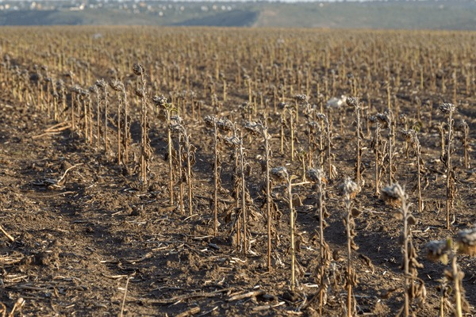
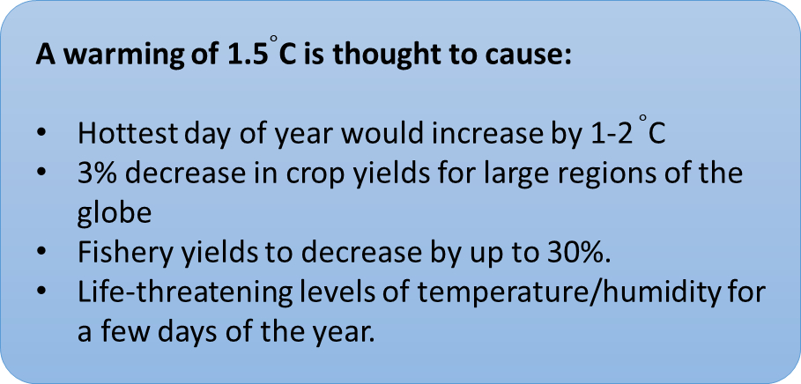
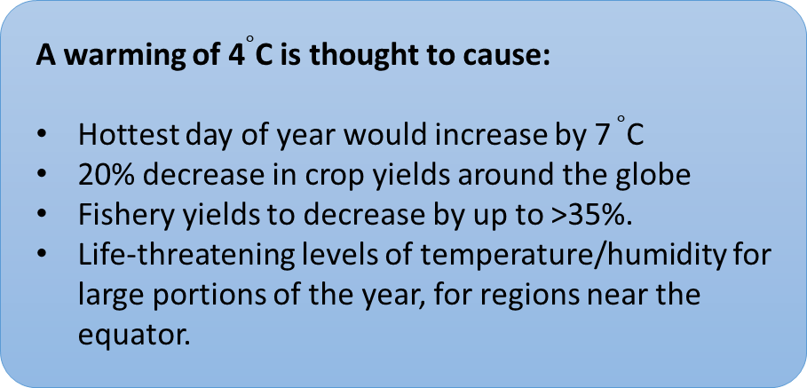
Consequences of a warming climate
A warming of 1.5$∘$C is thought to cause:
Hottest day of year would increase by 1-2 $∘$C
3% decrease in crop yields for large regions of the globe
Fishery yields to decrease by up to 30%.
Life-threatening levels of temperature/humidity for a few days of the year.
A warming of 4$∘$C is thought to cause:
Hottest day of year would increase by 7 $∘$C
20% decrease in crop yields around the globe
Fishery yields to decrease by up to >35%.
Life-threatening levels of temperature/humidity for large portions of the year, for regions near the equator.

Slide 7
Project Goal

Slide 8
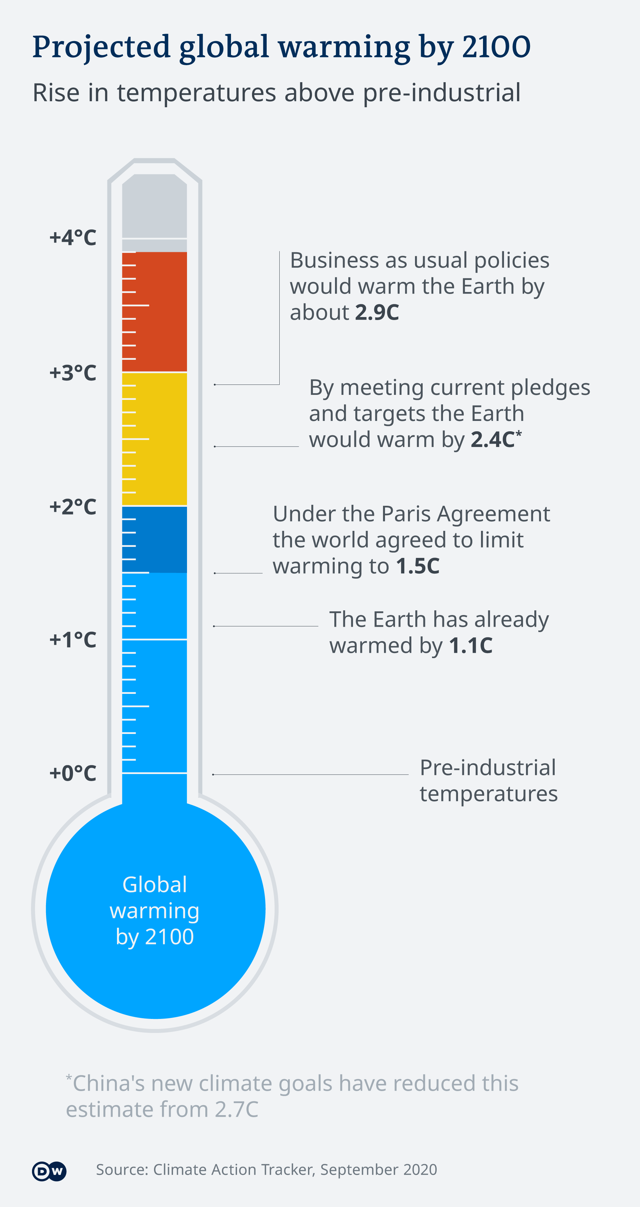
Project Aims
The Paris agreement
The next contender?
Consequences of this (wildfires, drought frequency)

Slide 9
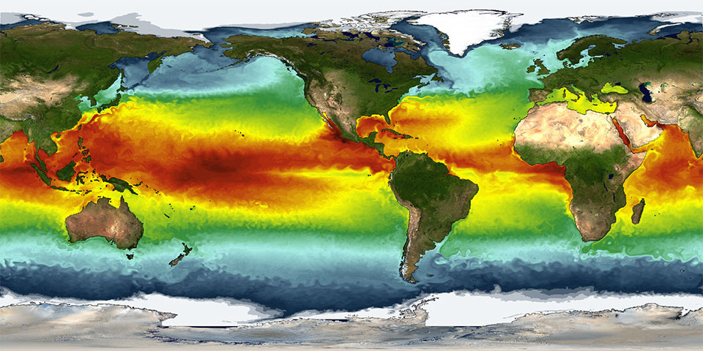
Modelling Earth’s Climate

Slide 10
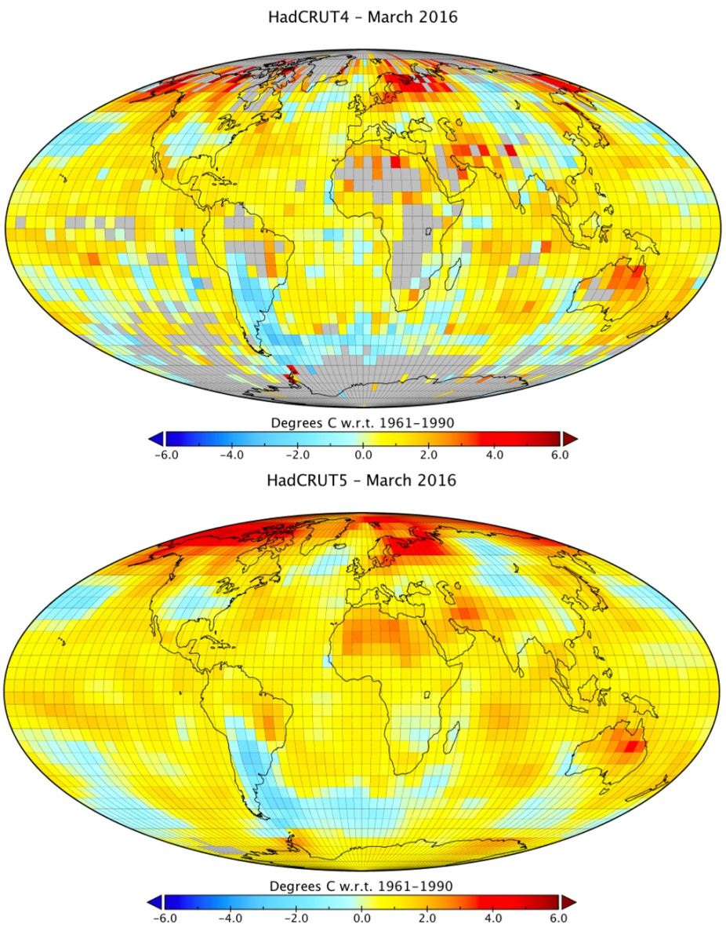
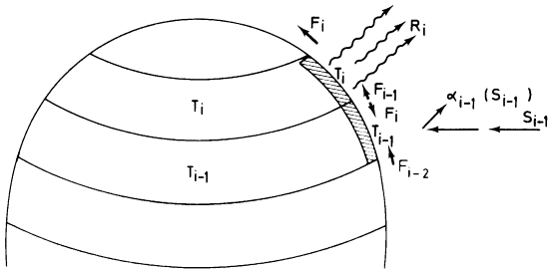
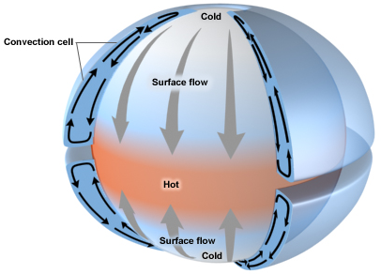
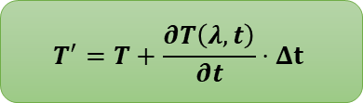
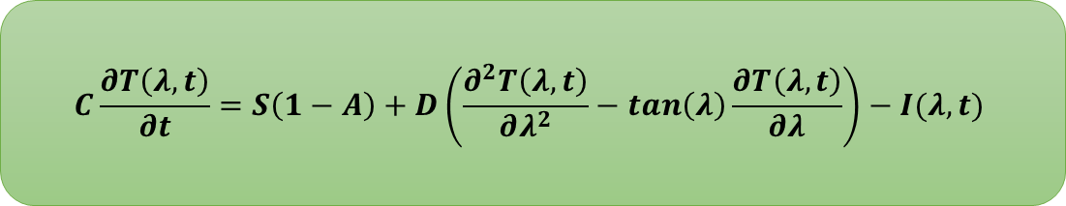
Climate Model
What is a 1-D EBM?
How do we utilise this P.D.E?
$$C\frac{∂T\left(λ, t\right)}{∂t}=S\left(1−A\right)+D\left(\frac{∂^{2}T\left(λ, t\right)}{∂λ^{2}}−\tan\left(λ\right)\frac{∂T\left(λ, t\right)}{∂λ}\right)−I(λ,t)$$
$$T^{′}=T+\frac{∂T\left(λ,t\right)}{∂t}⋅Δt$$

Slide 11
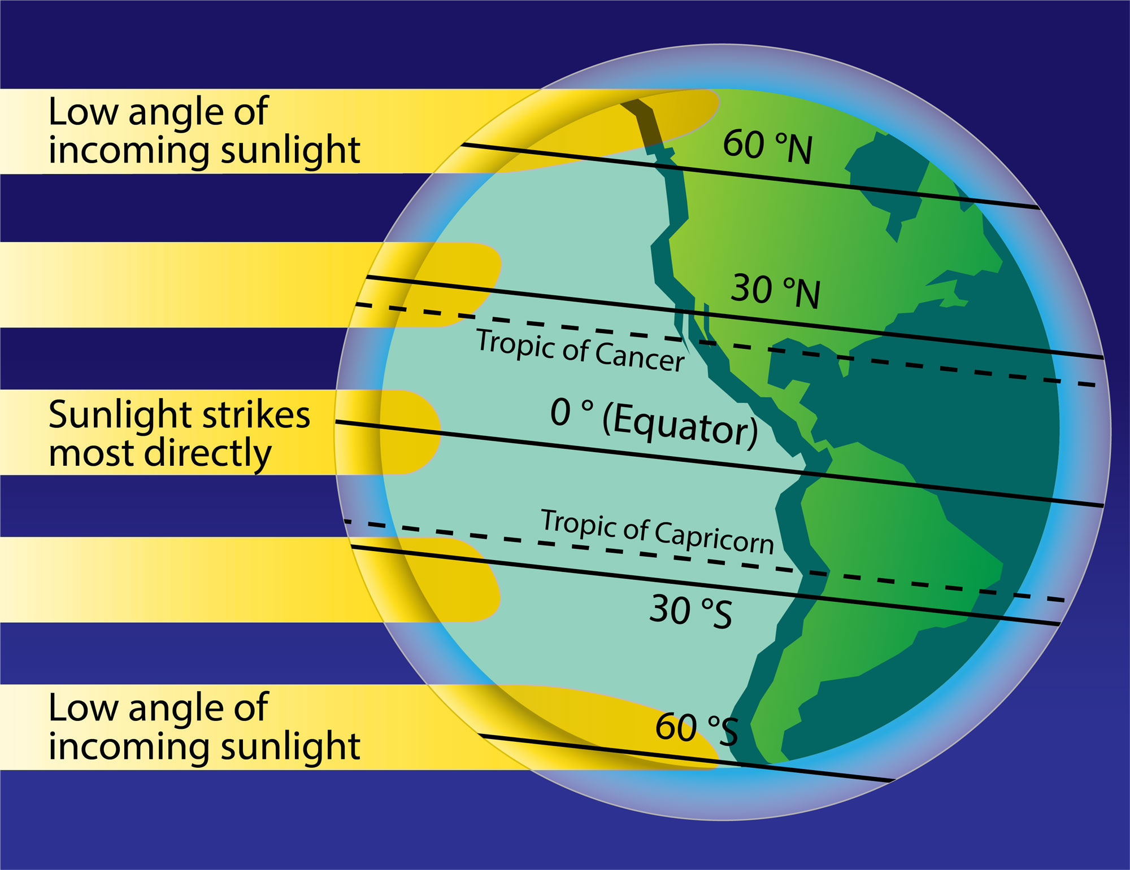
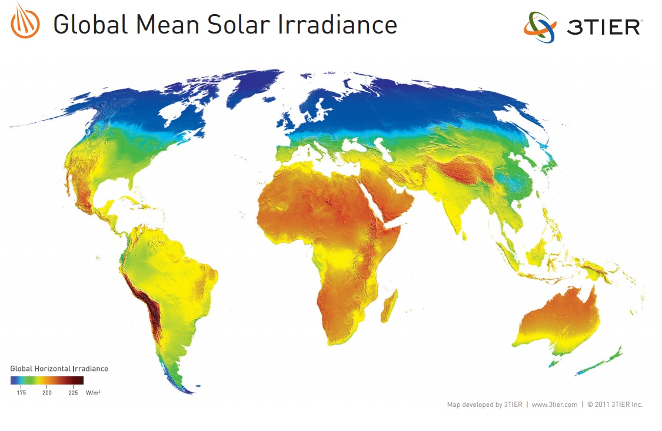
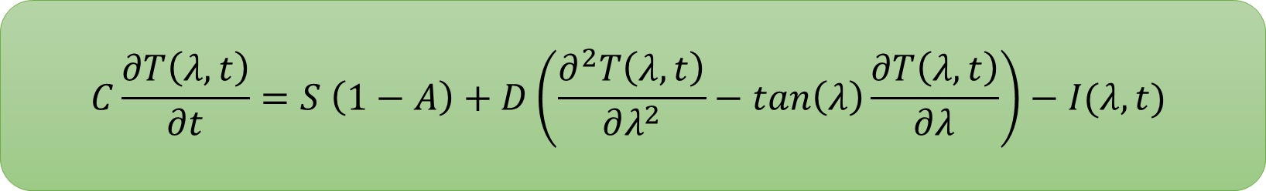
Solar Insolation
$$C\frac{∂T\left(λ, t\right)}{∂t}=S \left(1−A\right)+D\left(\frac{∂^{2}T\left(λ, t\right)}{∂λ^{2}}−\tan\left(λ\right)\frac{∂T\left(λ, t\right)}{∂λ}\right)−I(λ,t)$$

Slide 12
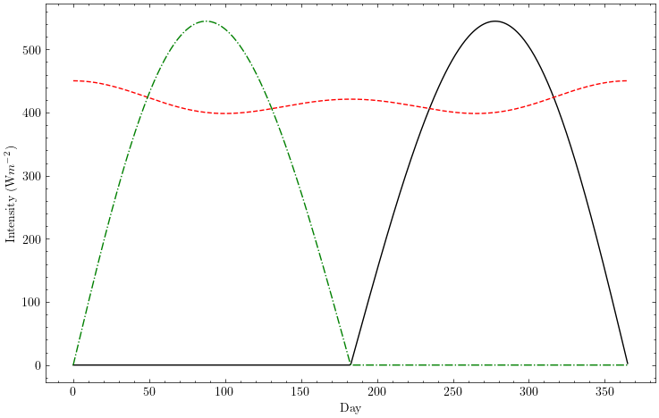

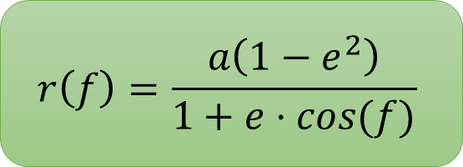

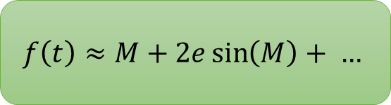
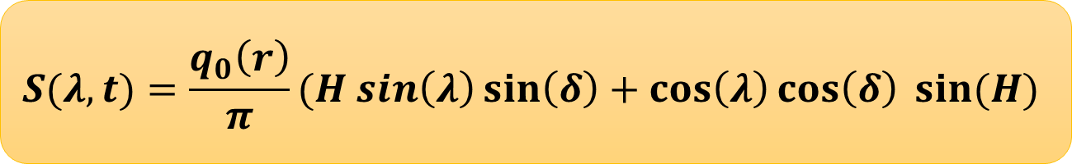
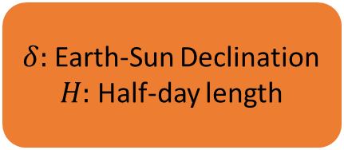
Solar Insolation
How do we calculate $S$?
$$f\left(t\right)≈M+2e\sin\left(M\right)+ …$$
$$r\left(f\right)=\frac{a\left(1−e^{2}\right)}{1+e⋅cos(f)}$$
$$q_{0}\left(t\right)=\frac{L_{sol}}{4π r^{2}}$$
$$S(λ,t)=\frac{q_{0}\left(r\right)}{π}(H sin\left(λ\right)\sin\left(δ\right)+\cos\left(λ\right)\cos\left(δ\right) sin⁡(H)$$
$δ:$ Earth-Sun Declination
$H:$ Half-day length

Slide 13
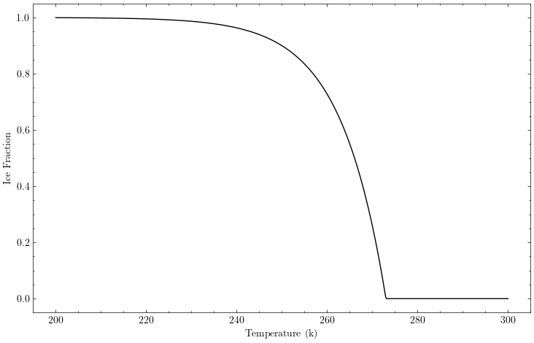
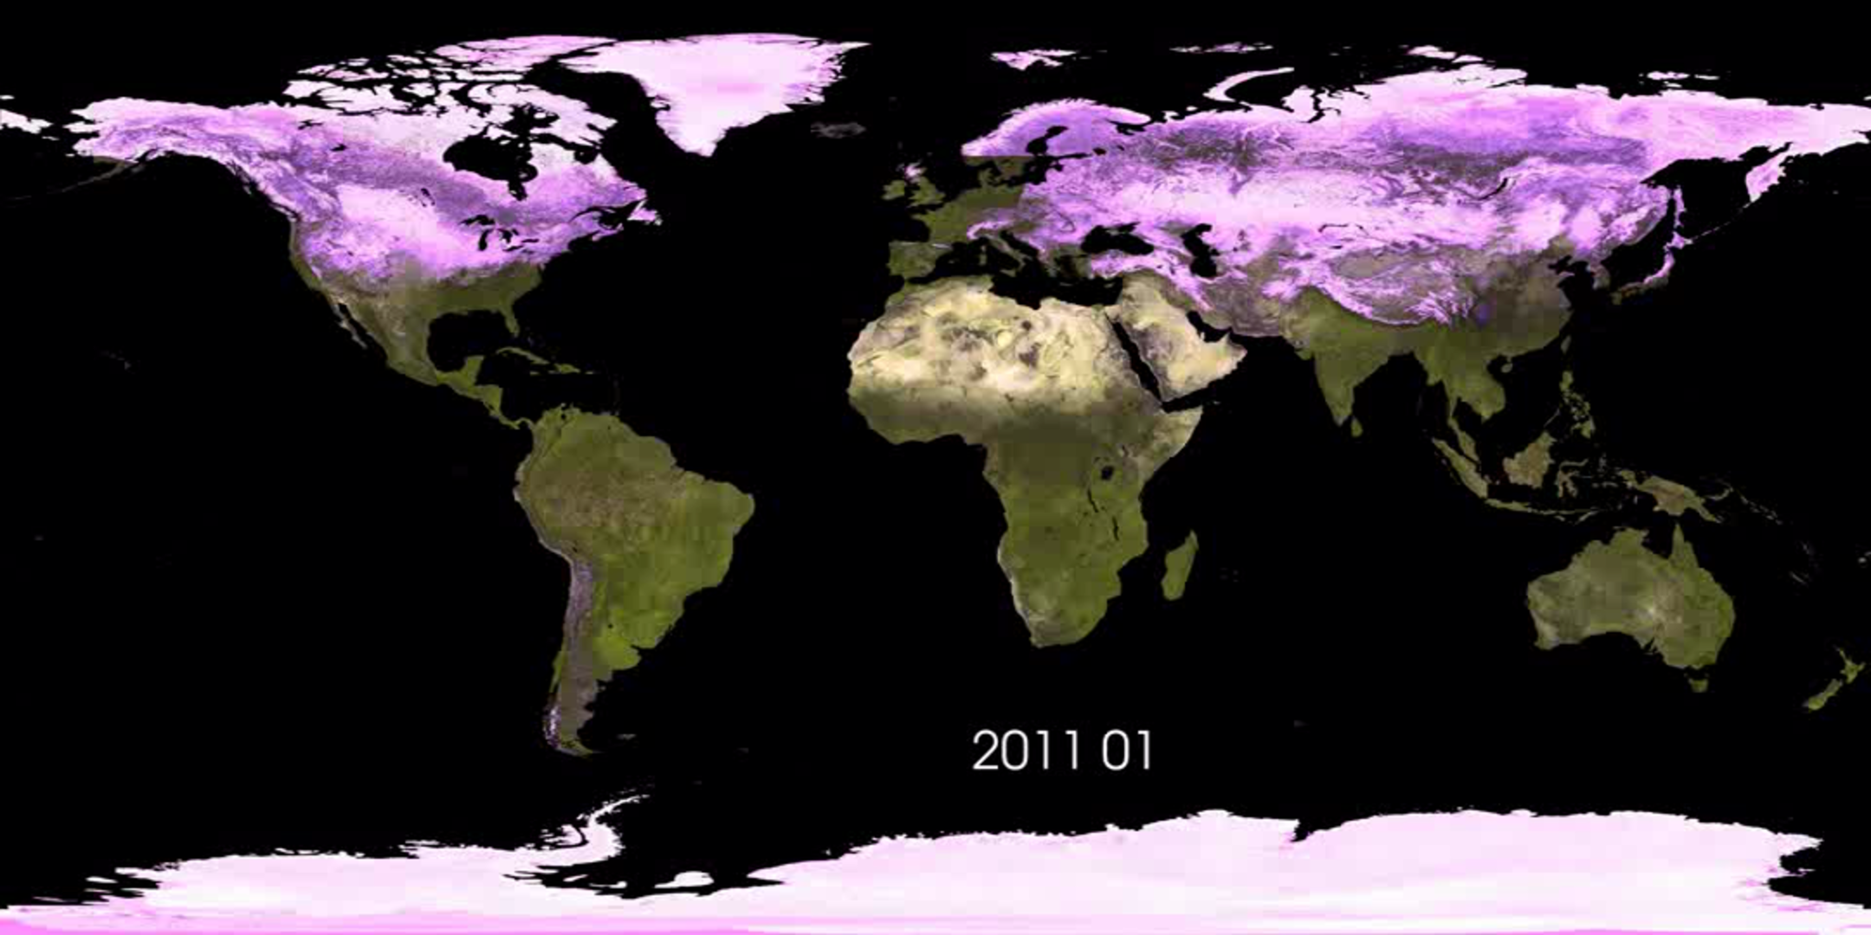
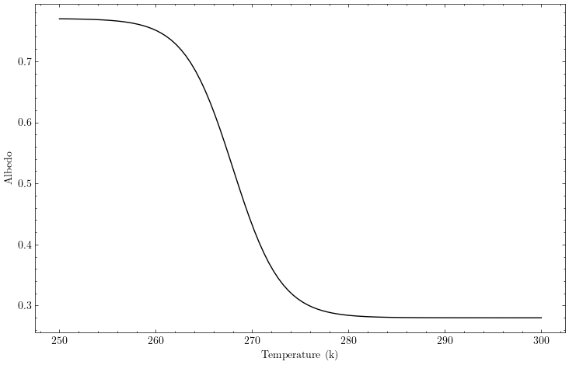
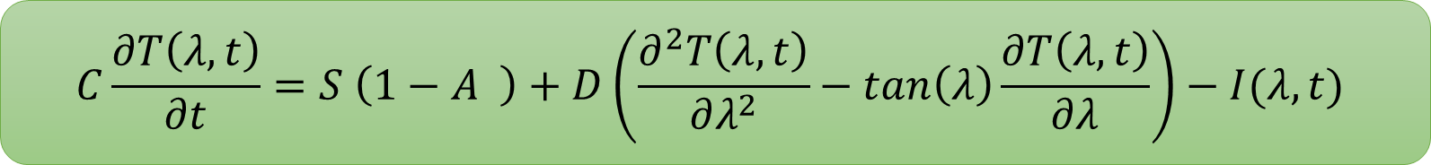
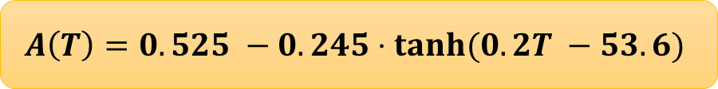
Surface Albedo
$$C\frac{∂T\left(λ, t\right)}{∂t}=S \left(1−A \right)+D\left(\frac{∂^{2}T\left(λ, t\right)}{∂λ^{2}}−\tan\left(λ\right)\frac{∂T\left(λ, t\right)}{∂λ}\right)−I(λ,t)$$
$$A\left(T\right)=0.525 −0.245⋅tanh⁡(0.2T −53.6)$$

Slide 14
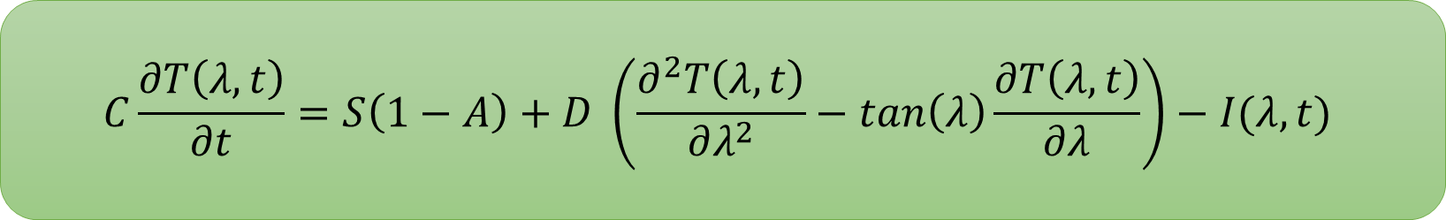
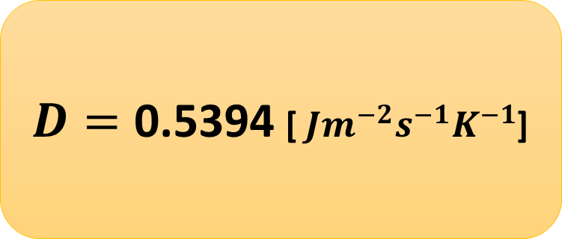
Latitudinal Heat Transport
$$C\frac{∂T\left(λ, t\right)}{∂t}=S\left(1−A\right)+D \left(\frac{∂^{2}T\left(λ, t\right)}{∂λ^{2}}−\tan\left(λ\right)\frac{∂T\left(λ, t\right)}{∂λ}\right)−I(λ,t)$$
$D=\text{0.5394}$ [ $Jm^{−2}s^{−1}K^{−1}$]

Slide 15
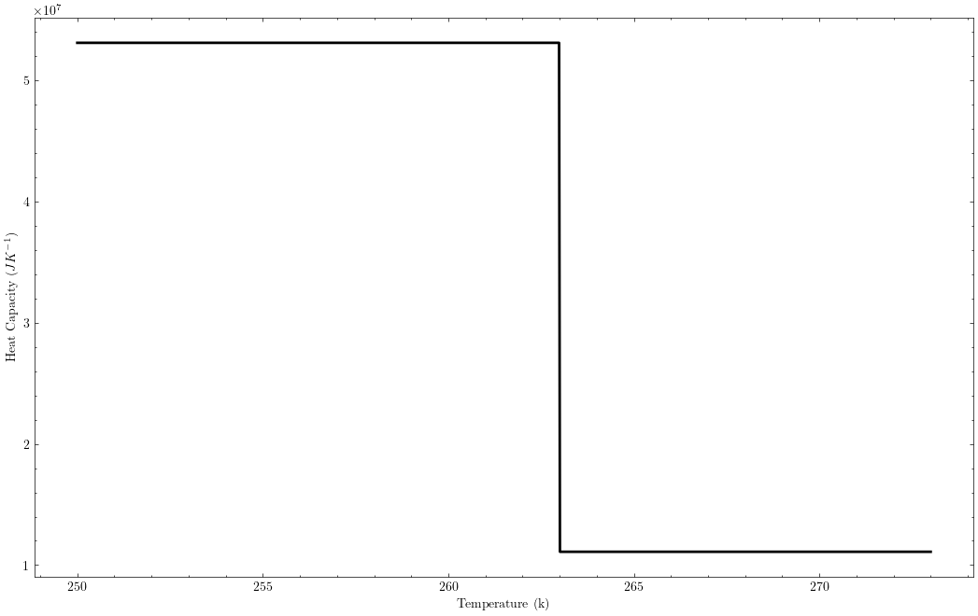
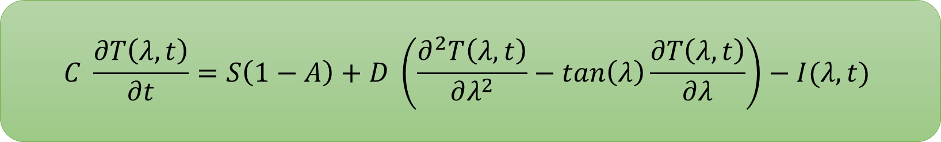
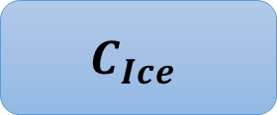
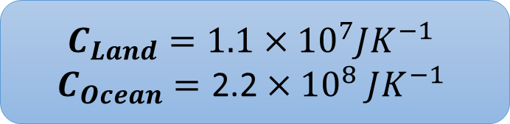
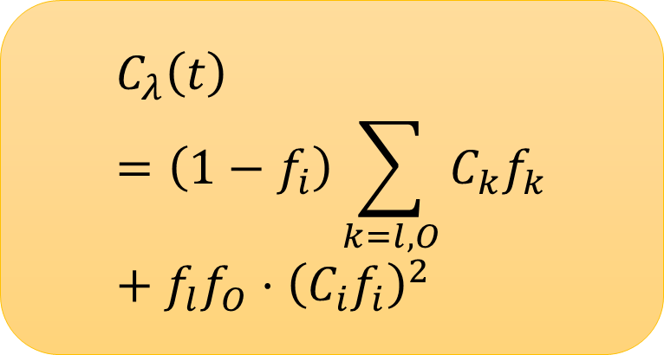
Heat Capacity
$$C \frac{∂T\left(λ, t\right)}{∂t}=S\left(1−A\right)+D \left(\frac{∂^{2}T\left(λ, t\right)}{∂λ^{2}}−\tan\left(λ\right)\frac{∂T\left(λ, t\right)}{∂λ}\right)−I(λ,t)$$
$$C_{Ice}$$
$$C_{Land}=1.1×{10}^{7}JK^{−1}$$
$$C_{Ocean}=\text{2.2}×{10}^{8} JK^{−1}$$
$$C_{λ}\left(t\right)=\left(1−f_{i}\right)\sum_{k=l,O}{C_{k}f_{k}}+{f_{l}f_{O}⋅\left(C_{i}f_{i}\right)}^{2}$$

Slide 16
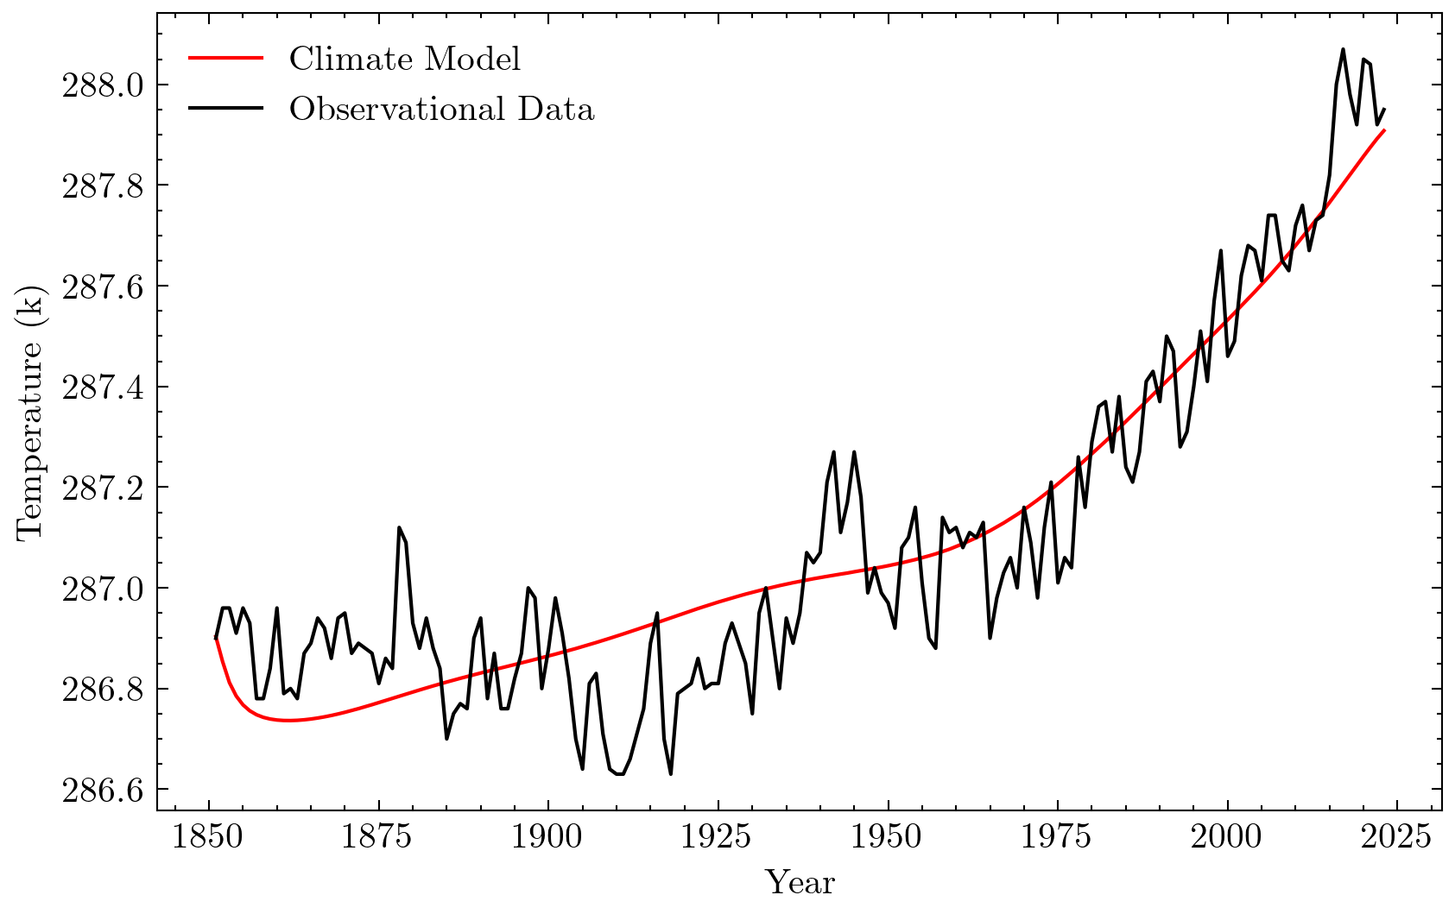
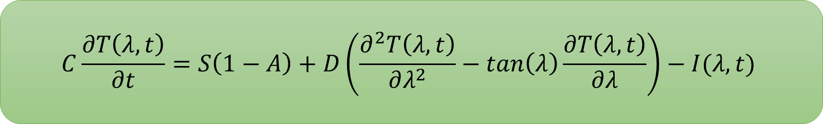
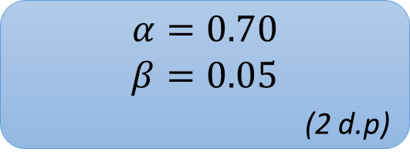
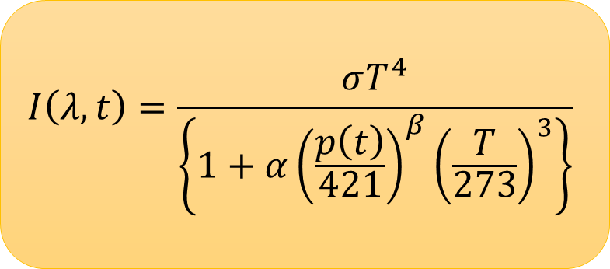
Infrared Cooling
$$C\frac{∂T\left(λ, t\right)}{∂t}=S\left(1−A\right)+D\left(\frac{∂^{2}T\left(λ, t\right)}{∂λ^{2}}−\tan\left(λ\right)\frac{∂T\left(λ, t\right)}{∂λ}\right)−I(λ,t)$$
$$I\left(λ, t\right)=\frac{σT^{4}}{\left\{1+α{\left(\frac{p\left(t\right)}{421}\right)}^{β}{\left(\frac{T}{273}\right)}^{3}\right\}}$$
$α=0.70$
$β=0.05$
(2 d.p)

Slide 17
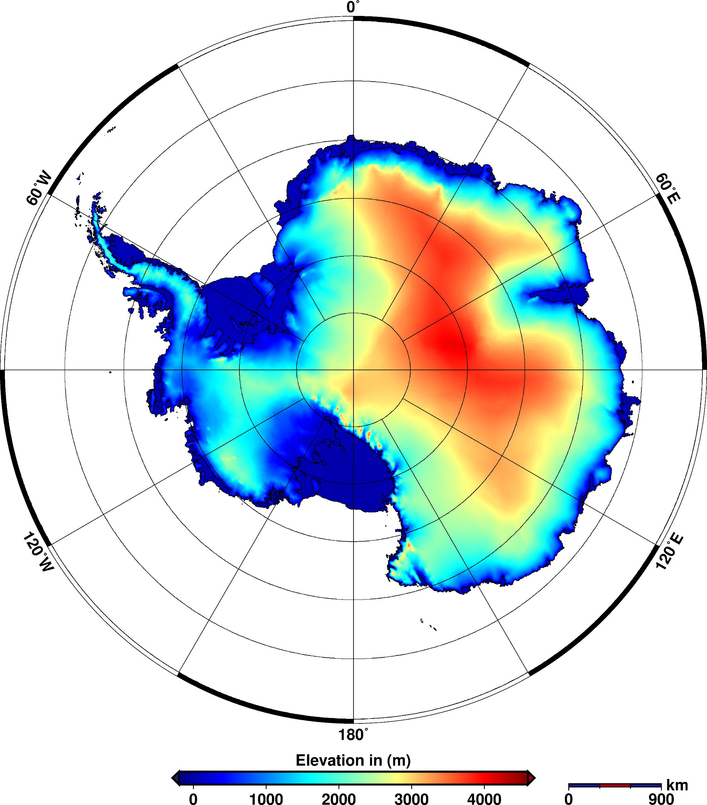



Antarctica
Why does Antarctica need special treatment?
Antarctica sits 2500m above sea-level
Significant surface albedo deviation
Lapse-rate correction
$$T^{′}=T −6.5 Δh$$
More realistic ice coverage/albedo profile

Slide 18

Possible future scenarios and climate consequences

Slide 19




Representative Concentration Pathways (RCPs)
How do we produce global temperature forecasts using our model?
RCP 8.5
Emissions continue to rise into 21st century
No preventative action taken
RCP 6
Emissions peak in 2080
Utilisation of technology.
Warming between $3^{∘c} \& 4^{∘c}$
RCP 4.5
Emissions peak in 2040
Warming between $2^{∘c} \& 3^{∘c}$
RCP 2.6
Emissions peaked in 2020
Tend to zero by 2100
Warming $<2^{∘c}$

Slide 20




Temperature Forecasts
RCP 8.5
Warming of ${2.3}^{∘c}$ by 2100, with a trend of more warming to come.
Significant melting of the ice caps.
Largest increase in sea levels.
Increased frequency/severity of wildfires & droughts.
RCP 4.5
Warming of ${0.5}^{∘c}$ by 2100, coming to an equilibrium.
Moderate degree of ice cap shrinkage and change in sea-levels.
RCP 2.6
Slight decrease in global temperatures due to stringent negative emissions.
Minimal change in sea-level and ice cap volumes.

Slide 21

Next Steps
Quantify warming consequences more thoroughly
Model frequency of wildfires & droughts
Q&A

